Slide 1
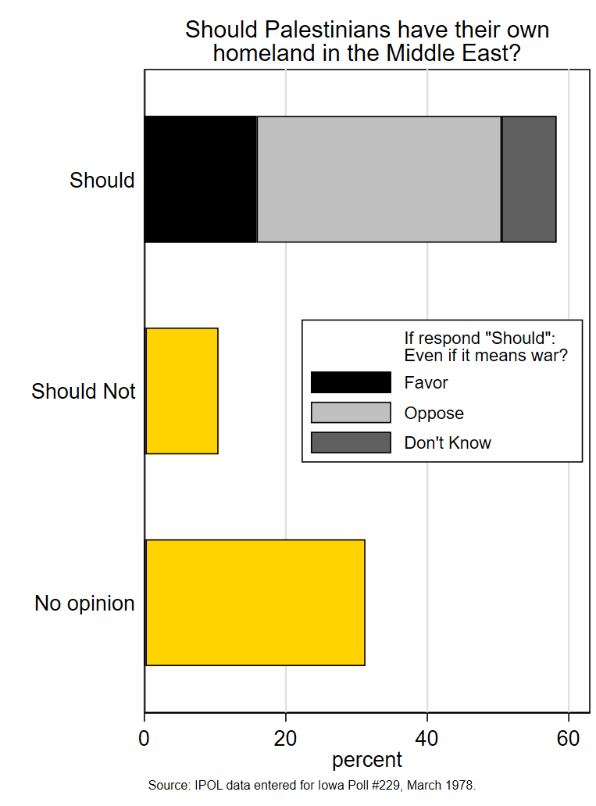
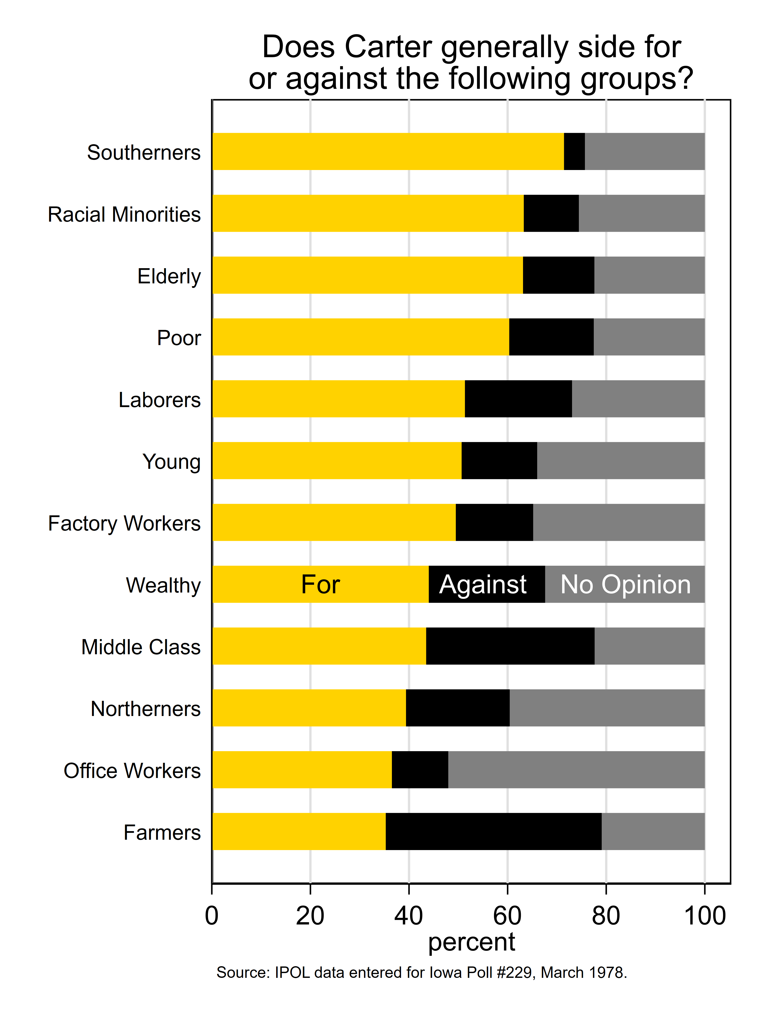
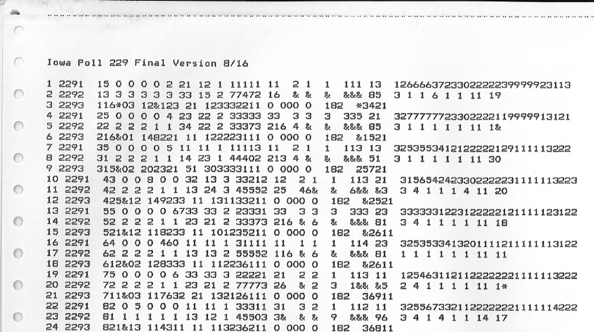
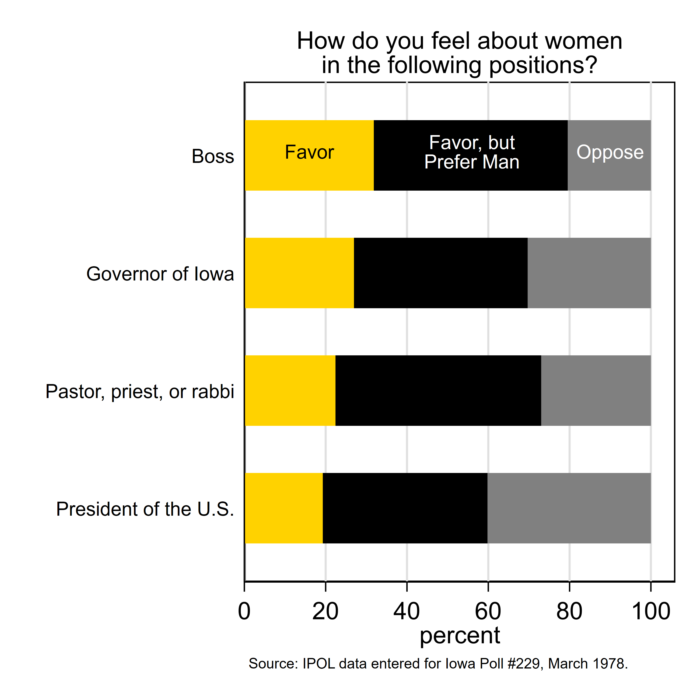
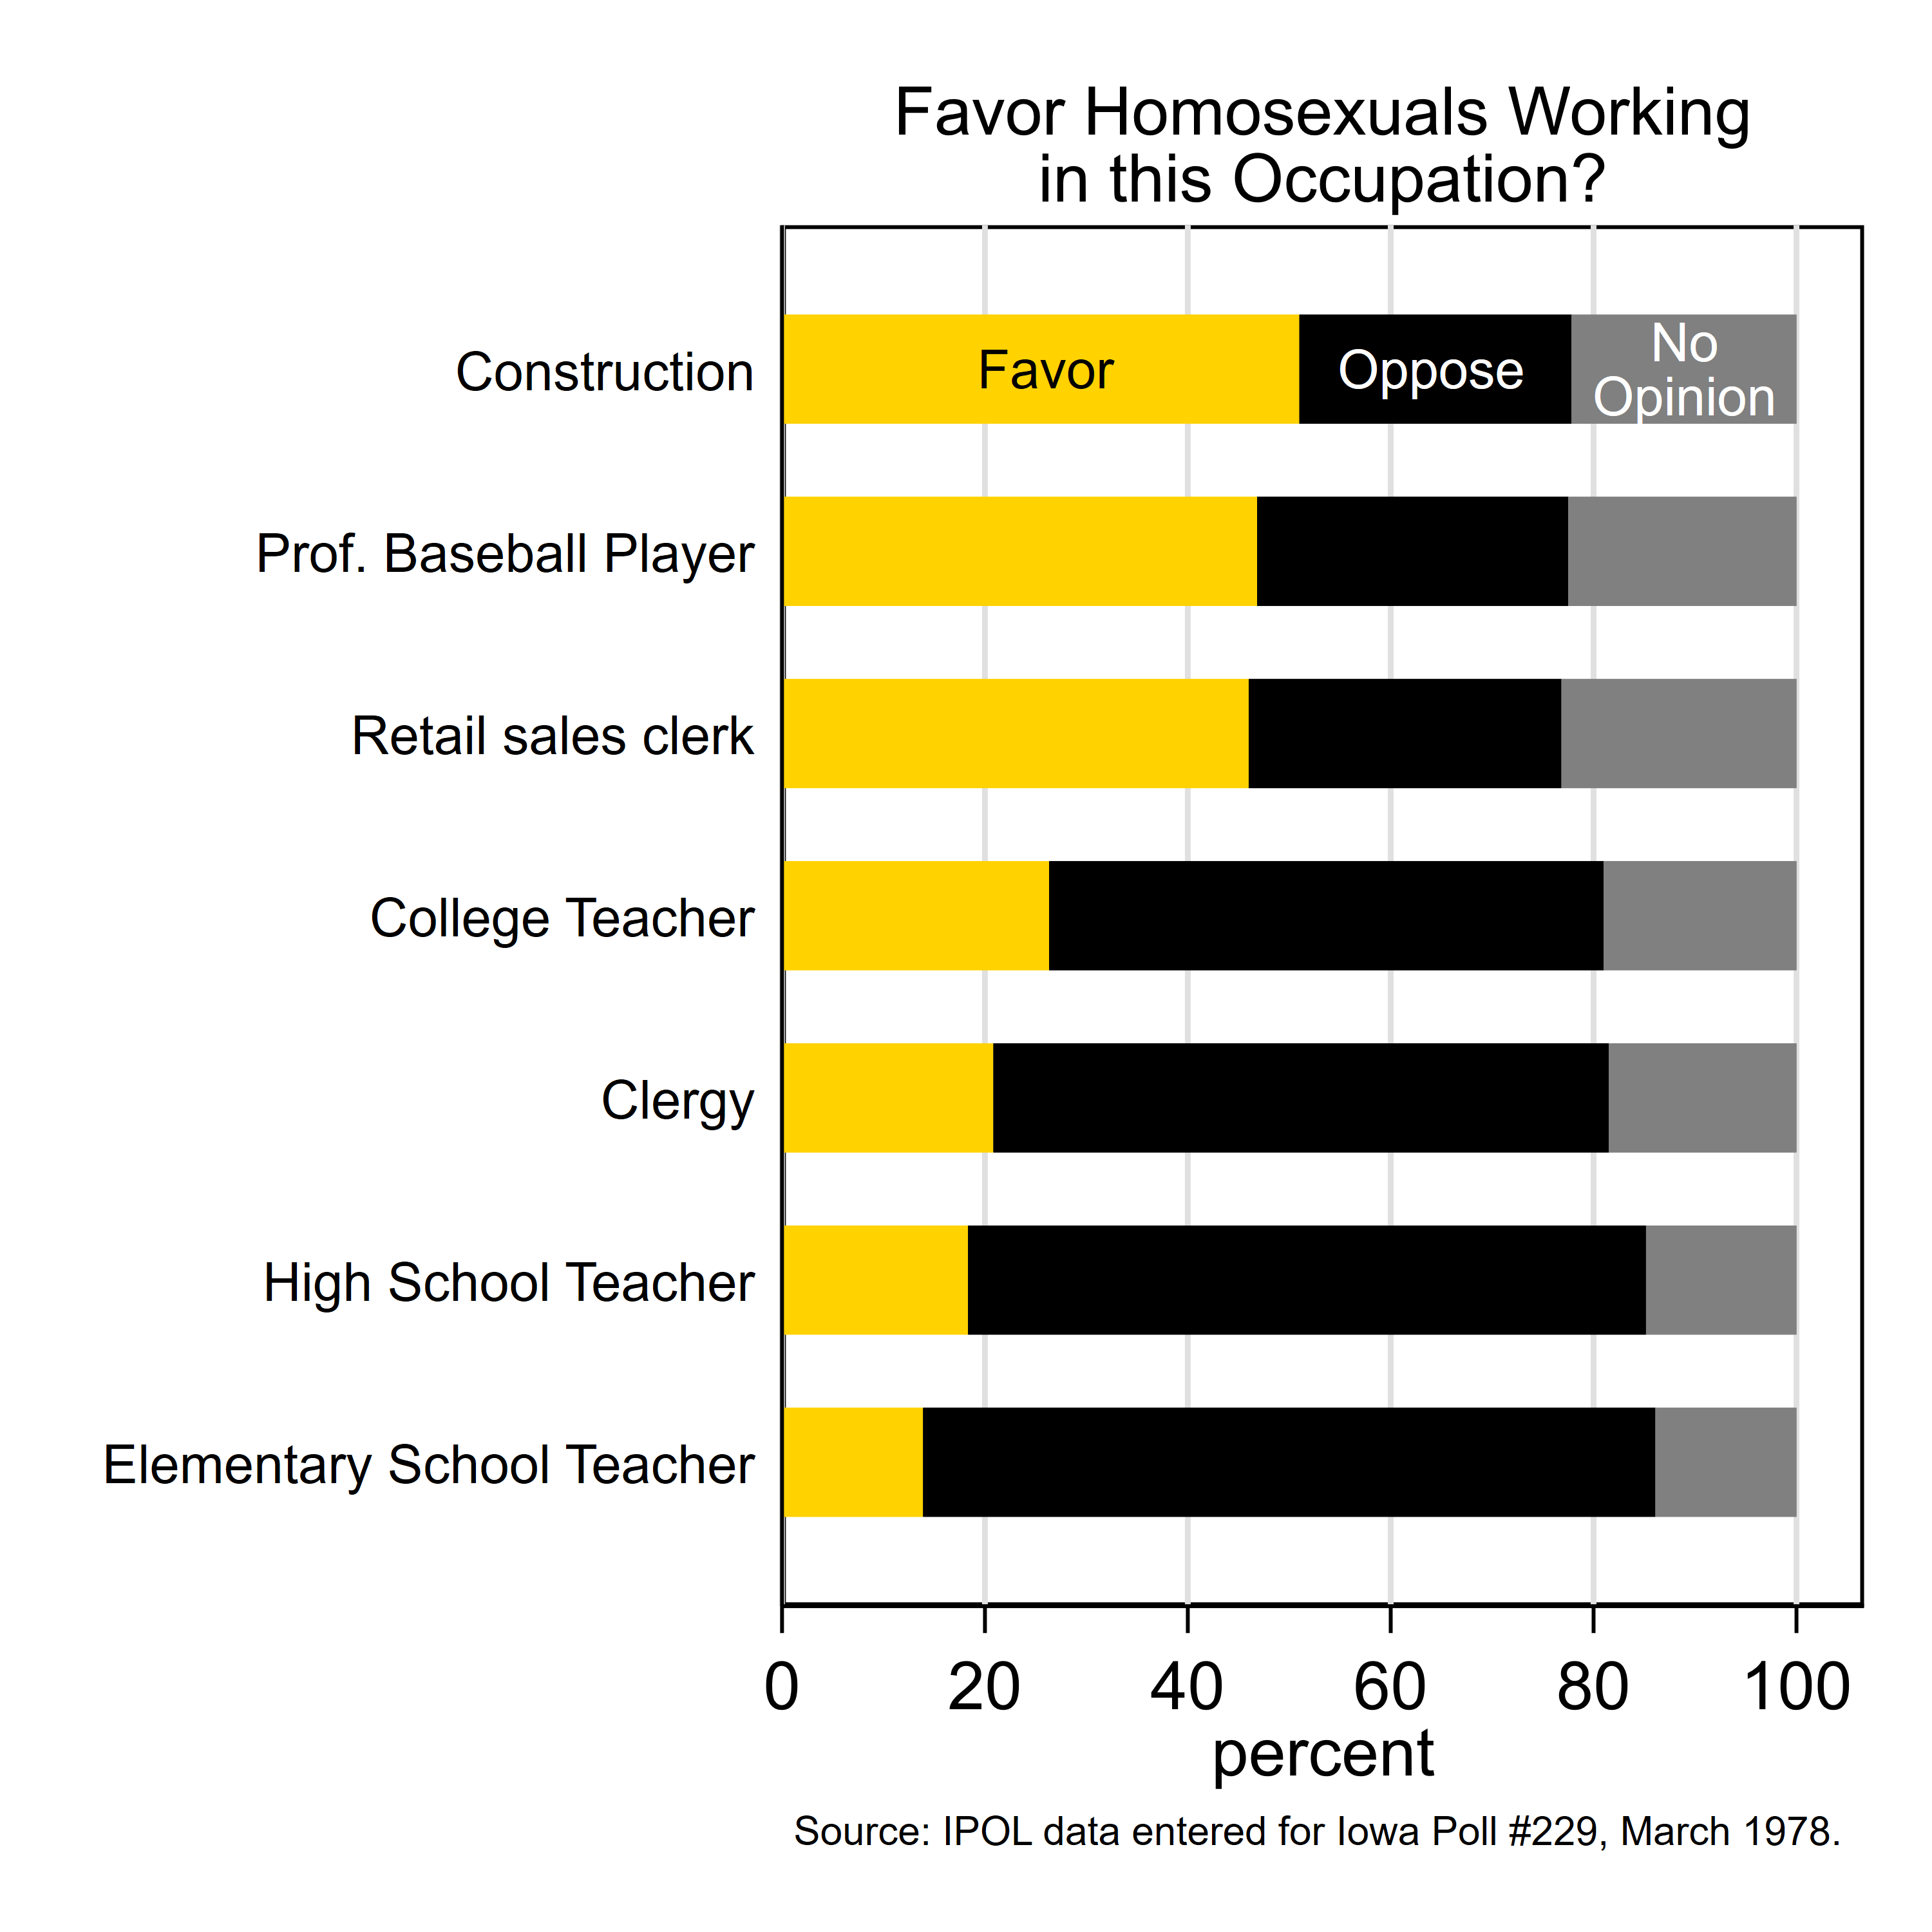
Iowa Policy and Opinion Lab: Restoring Historical Iowa Polls
Thom Blair, Makenna Gregurek, Yunseo Ki, and Kaitlin Knape
University of Iowa
Middle East and Palestine
About IPOL
Who Does President Carter Support?
59% of respondents would support a Palestinian homeland.
Of those, 59% would no longer support a Palestinian homeland if granting it caused a war.
Higher levels of education completed by respondents correlate with higher support for a Palestinian homeland.
Conversely, higher levels of education completed by respondents correlate with lower continued support in the event of a war.
The Iowa Policy and Opinion Lab is a research group with about 20 student associates who collaborate to study policymaking and public opinion in Iowa. Currently, the students are restoring rediscovered Iowa opinion polls from 1946 to 1981 originally conducted by the Des Moines Register to examine and compare responses to modern-day opinions.
Less than 50% of respondents in all age ranges believed Carter was not supportive of the wealthy.
35% of respondents believed Carter supported farmers while 43% answered “against.”
Combined, 73% of Republicans and Democrats believed that Carter sided with Southern states.
Across age groups, 50% of respondents believed that Carter supported the young.
Restoring Historical Iowa Polls​
​
We received boxes of old Iowa Poll questionnaires and data sets from the 1940s through the 1980s from the estate of Tom Mans, UI PhD in Political Science, 1981.
Unfortunately, we were unable to retrieve the survey data from the 40 year-old tape reels.
So we double-entered it by hand from the printed copies we received, totaling about 200,000 entries.
Homosexuals in Society and Professions
Women in Leadership Roles
20% of respondents would oppose having a female boss.
30% of respondents would oppose having a female governor of Iowa.
27% of respondents would oppose having a female pastor, priest, or rabbi.
40% of respondents would oppose having a female U.S. President.
Iowa Poll #229​
More than half of respondents opposed gay individuals working as teachers or clergy.
Less than a quarter of respondents opposed gay individuals working in other positions.
Conducted by the Des Moines Register.
Completed 600 face-to-face interviews with Iowans from March 15-18, 1978.
Asked over 100 questions about Iowa politics, international issues, travel, and sports.
Acknowledgments
IPOL is grateful for support received through the University of Iowa’s Public Policy Center, the Provost’s Office of Engagement, UI's Strategic Initiatives Fund, and the Marvin and Rose Lee Pomerantz Chair in Political Science. We also thank Carol Hunter at the Des Moines Register for her assistance.

